Slide 1
Phishing: Predator Catchers
By: Sloka + Fiyin co. 2026

Slide 2



Slide 3

San Jose, Costa Rica

Slide 4
Company Name - Predator Catchers
Industry - Trying to catch the hackers. Also, to make a service for children/adults to catch them and spread awareness to not get caught in this trap!
Employees - 75,000 people working with our company
Digital Footprint will be wiped in some circumstances of your vulnerabilities so that no one will take your personal information

Slide 5
Network Diagram.md
Our company is a networking surveillance team
As project manager I oversee and manage timelines, assigning tasks to the Ai engineer and BA of our company, Predator Catchers.
Our BA (Business analyst) creates graphs, flow charts and diagrams for the team to setup a clear way to help create a solution to aid the phishing problem across the internet.
The AI engineer of the team helps develop and deploy computer visions. They detect anomalies in the system and ensure a network can automatically track, and alert security events.
.

Slide 6
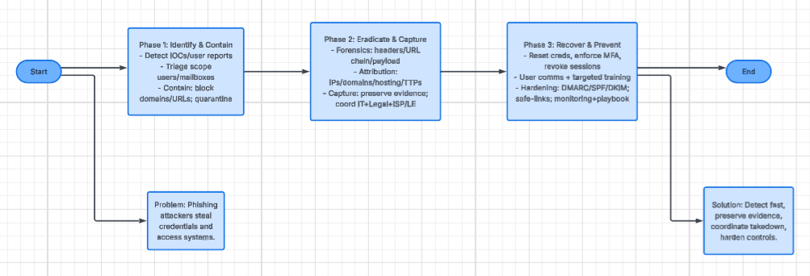
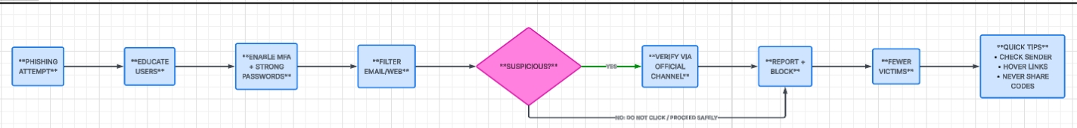
Flow + Time

Slide 7
Deliverables
S. C. A. M
S- Surveillance
C- Capture (Hackers)
A- Access
M- Monitor
The acceptance criteria to join Phishing: Predator Catchers is highly selective
Consequently to be a BA (Business Analyst) of our team, you are required to translate raw information on the Phishing attacks into clear cut, precise flow charts and documents.
To become and AI engineer you must build and deploy phishing/surveillance anomalies at greater than or equal to 98% accuracy; with false positive rates less than or equal to 1%. They must also integrate continuous data drift detection and self correction workflows matching the timeline.

Slide 8
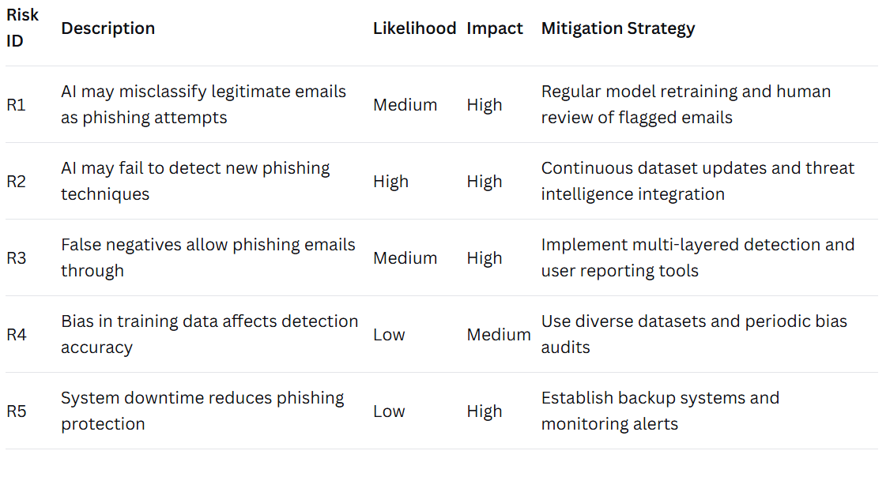
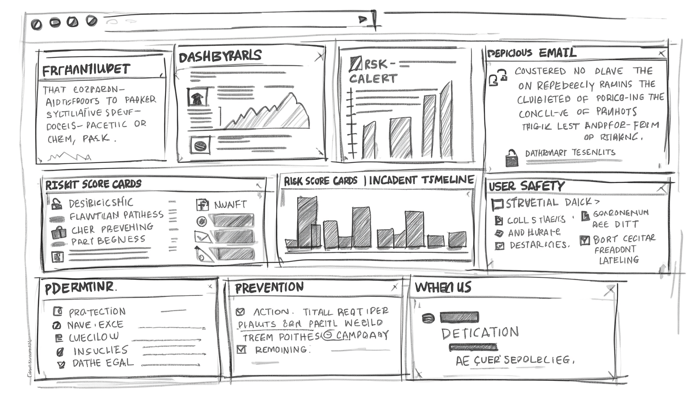
Risk Log + Graphs

Slide 9
Milestones & Goals
For our team we strive to meet client expectations almost all of the time. Our BA (Business Analyst) helps to bring our team together by translating data into charts that can help us comprehend. Lastly, As project manager I ensure that our team meets the required standards.

Slide 10
Role Based Access Controls
AI Engineer
The technical builder of the team who develops models and algorithms through AI to create solutions to any problems.
BA (Business Analyst)
They are the problem identifier of the team who connects technical team with stakeholders; they define the what and why -gathering requirements.
Project Manager
The person who makes timelines and orchestrates and handle risks to ensure the team builds the solution correctly on schedule.

Slide 11
Risks
Risks can include multiple things if you get caught in the scam. Risks can be either small to huge, significant problems and conflicts. Some include financial loss, identity theft, reputational damage, and operational disruptions for people or huge businesses! If you don’t follow our protocols or our steps key for our foundation then you may get caught in this phishing scam. Our company, Predator catchers, informs you and helps you not get caught in these phishing scams.

Slide 12
Training Strategy.md
Our company educates and teaches our employees our rules and how to prevent accidents from happening in phishing incidents. It also gives the best practices for our employees to learn the best knowledge they can get and discover. Our company has a specialized plan to make our employees knowledgeable, share information, and protect them also from phishing scams and techniques. We have some rule books, and some websites other employees have created to help people and our company’s customers learn and explore our ways on benefiting people information.

Slide 13
Risk Management.md
Top Three Risks for Phishing that can get you pulled in.
One: Attackers send emails that mimic trusted sources. People can get very very deep and into the scam. It looks very trustworthy. Make sure to Verify, use MFA, report, and avoid clicking + downloading.
Two: Highly targeted attacks use personal or lots of research to have convincing ways to manipulate you. Be cautious, limit access and block suspicious sites
Three: Malicious links or files can install malware, ransomware, or spyware. Hover over links, scan attachments, keep software patched, and use email security gateways.

Slide 14
Incident Response
Cybersecurity incident response (IR) is an organization’s organized methodology for detecting, containing, and recovering from cyber attacks or data breaches. The primary goal is to limit damage, minimize operational downtime, and prevent future incidents by following a structured, standardized plan.

Slide 15
Object 01
GUESS THE OBJECT
OBJECT 01

Slide 16
GUESS THE OBJECT
WINNER
CONGRATULATIONS, THE WINNER IS XXX!

Slide 17
GUESS THE OBJECT
OBJECT 02
Answer.
Answer Here

